Slide 1







Slide 2
Chapter #2
FIAT MONEY
Its Problems, and the Search for Solutions

Slide 3



What Is Fiat Money and Who Controls It?

Slide 4

What Is Fiat Money and Who Controls It?
2.0 Introduction
The history of mankind is the history of money losing value.
Milton Friedman
We saw in the previous chapter how money evolved over time and how our monetary system transitioned from sound to unsound money, shaping the world we live in today. This chapter dives deeper into how these developments led to today’s ﬁat system and how that ﬁat system works.
So, what does this ﬁat system look like, and how did it come into existence? To answer this question, we need to begin by centering our attention on the US dollar, the world's current reserve currency, which plays a dominant role in today’s world. Every country, directly or indirectly, feels the impact of the decisions made regarding the US dollar. To truly understand how the ﬁat system operates in your country, it is essential to unravel the historical threads that connect it to the ﬁat system's birthplace — the United States of America.

Slide 5

What Is Fiat Money and Who Controls It?
Brief History of Fiat Money
1815-1933 | 1913 | 1933 | 1934 | 1944 | 1971 | 1980
Gold standard | Creation of the Central Bank called “The Federal Reserve” | Executive Order 6102. Every citizen was obliged to turn in their gold at an exchange rate of $20.67 per ounce. | Gold Reserve Act. Stealing wealth from the people by devaluing the dollar by 40% to $35 per ounce of gold. | Bretton Woods Agreement: USD became the dominant world reserve currency. | Nixon Shock, which gave birth to the ﬁat system by ending the redeemability of U.S. dollars for gold. | Value of gold increased from $35 per ounce in 1970 to $870 per ounce in 1980, which caused people’s money to lose 96% of its value in just 10 years
Timeline Visual
In the 19th century, civilizations worldwide thrived on a sound money standard, using precious metals like gold and silver due to their scarcity, durability, and recognizability. As global trade grew, carrying large amounts of metal became challenging, leading to the emergence of gold and silver warehouses. These warehouses securely stored people's valuable metals and provided paper certiﬁcates redeemable for speciﬁc amounts of gold or silver. In exchange for depositing their money, individuals received paper certiﬁcates directly tied to the exact amount of gold or silver they stored. This direct link between paper certiﬁcates and tangible commodity money marked the early stages of what we now recognize as banks.

Slide 6
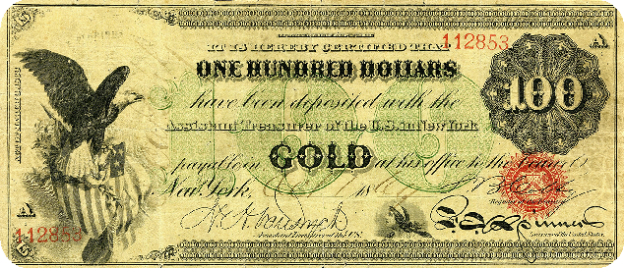
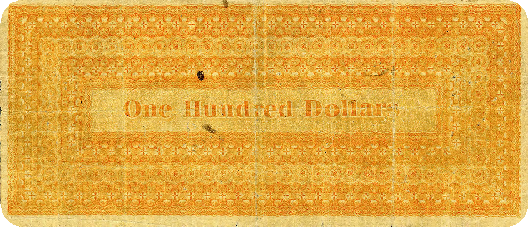
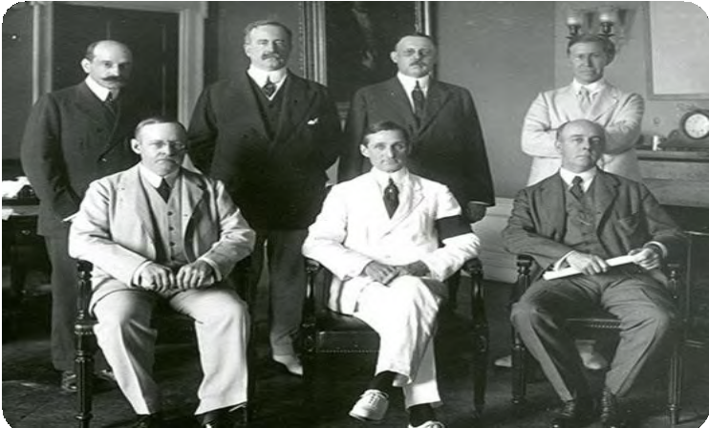
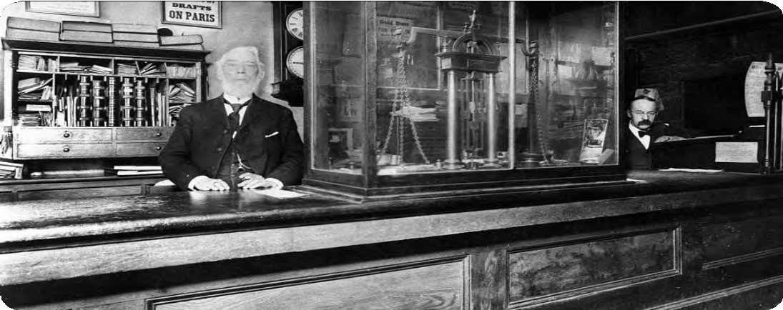
What Is Fiat Money and Who Controls It?
Initially, banks aimed to safeguard clients' money but later engaged in risky lending practices, issuing certiﬁcates for gold they didn't have. This practice posed the threat of bank runs if too many clients claimed their money simultaneously.
To address the risk, banks collaborated with governments to establish a system legalizing re-lending.
In 1913, they created the Federal Reserve, a central bank responsible for generating new paper certiﬁcates and bailing out troubled banks. Globally, governments recognized the value of gold and silver, leading to conﬂicts and wars for control.
In the years leading to World War II, leaders like Lenin, Stalin, Churchill, Roosevelt, Mussolini, and Hitler seized gold for strategic purposes.

Slide 7
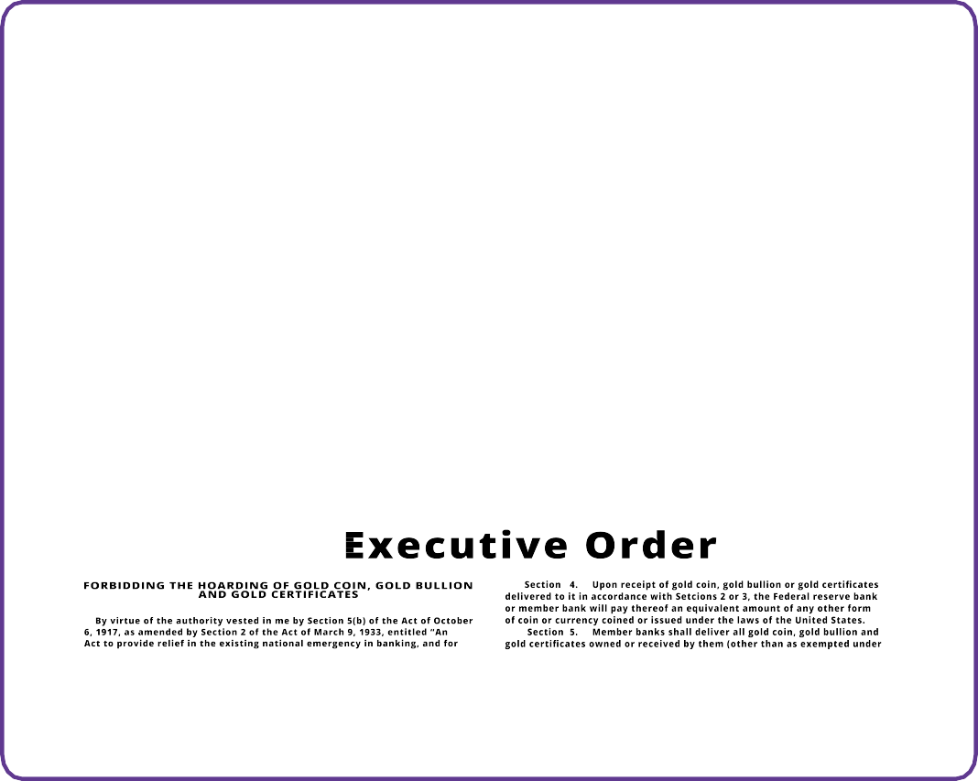












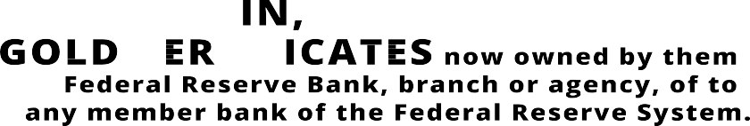
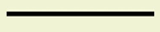
What Is Fiat Money and Who Controls It?
In the early 1930s, a signiﬁcant change occurred in the way money was backed by assets in the United States. At that time, a lot of people’s wealth was stored in the form of gold. However, in 1933, President Roosevelt issued Executive Order 6102, which demanded that every citizen give up their gold. This wasn't a voluntary exchange — people were required to surrender their gold, and if they refused, they faced severe penalties.
The government set the exchange rate at $20.67 per ounce of gold. This meant that for every ounce of gold a person had, they received paper certiﬁcates equivalent to
$20.67. People had to accept these paper dollars, hoping that one day, they would be able to exchange them back for gold.
In 1934, the Gold Reserve Act allowed people to exchange their paper dollars for gold again.
However, there was a catch: the government deliberately devalued the paper dollars by increasing the exchange rate to $35 per ounce of gold. This devaluation hit
hard-working individuals in the lower and middle classes as it meant that their savings, once worth more, were now worth less due to the decrease in the value of the paper dollars.

Slide 8
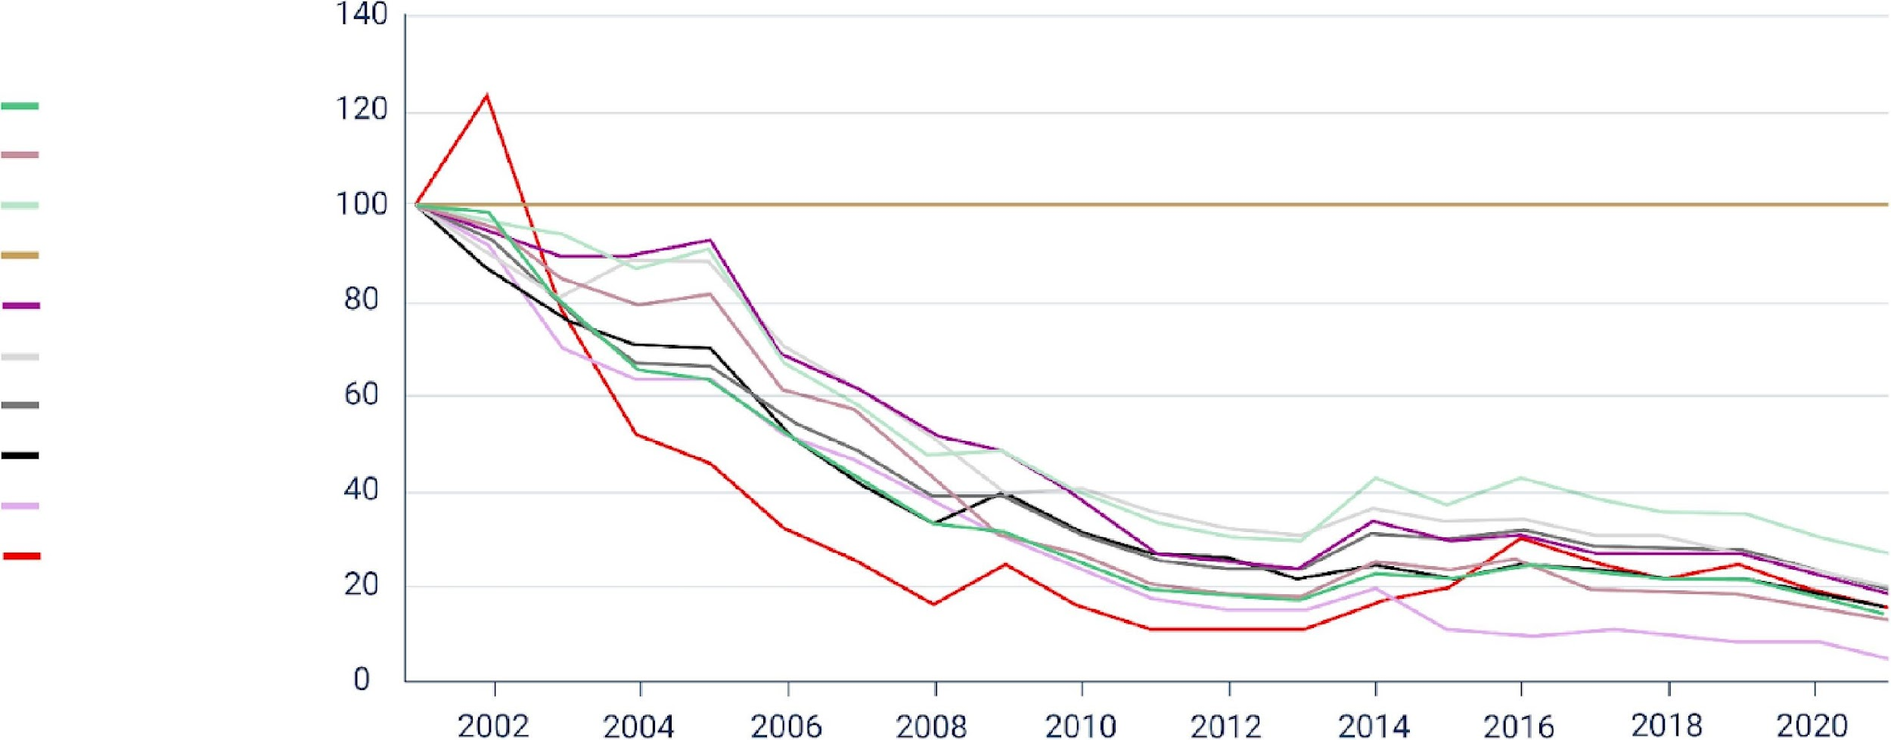
What Is Fiat Money and Who Controls It?
After World War II, the Bretton Woods agreement in 1944 established that the US dollar would be the world's reserve currency, and it could be exchanged for gold. However, this link between the U.S. dollar and gold was severed in 1971 when President Nixon ended the redeemability of the U.S. dollar for gold.
This marked a signiﬁcant shift, leading to the adoption of a ﬁat money system where the value of the currency is not backed by a physical commodity like gold but rather by the trust and conﬁdence of the people who use it. As governments and central banks retained most of the people's gold, the value of gold surged, reaching $870 per ounce in 1980.
Value in ounces of US$/gold
US Dollar Pound Sterling Swiss Franc Gold
Euro
Australian Dollar Singapore Dollar Yen
Russian Ruble Commodities

Slide 9
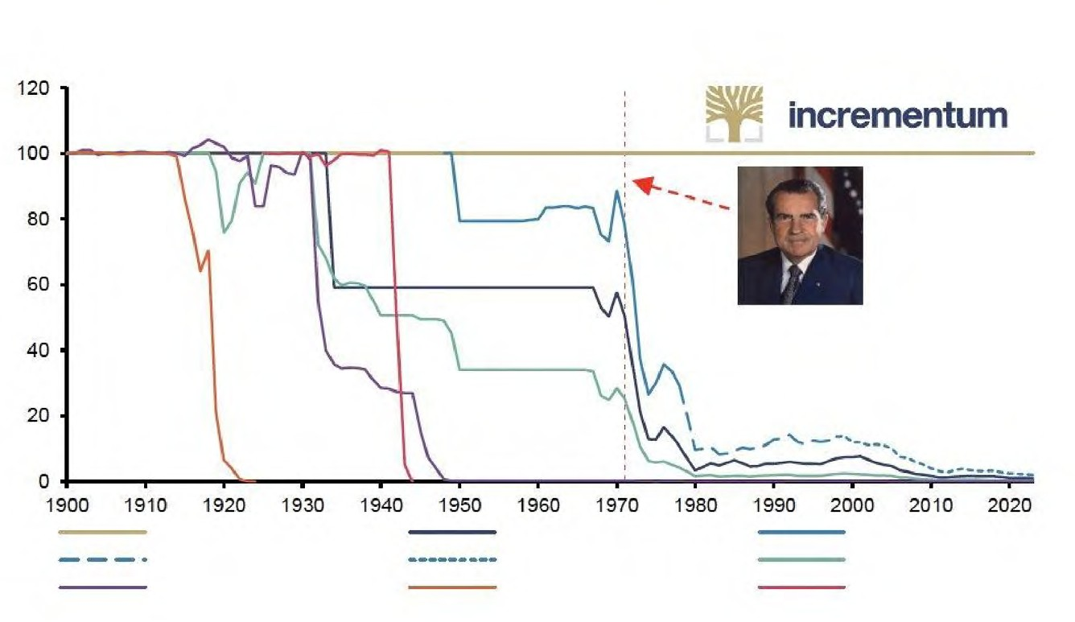
What Is Fiat Money and Who Controls It?
Gold and Various Currencies Measured in Gold, 1900-2023
In conclusion, the story of how human society transitioned from a sound money standard into an unsound (ﬁat) standard tells us how governments and banks captured precious metals from their citizens. While real money ended up in the pockets of governments and banks, the people were left with pieces of paper whose only value comes from governments mandating its use.
Gold ECU JPY
USD EUR
Mark
Deutsche Mark GBP
Reichsmark
Source: World Gold Council, Reuters Elkon, incrementum AG

Slide 10

What Is Fiat Money and Who Controls It?
The Fiat System
The root problem with conventional currency is all the trust that’s required to make it work. The central bank must be trusted not to debase the currency, but the history of ﬁat currencies is full of breaches of that trust.
Satoshi Nakamoto
Humanity transitioned from sound money controlled by the many to unsound money controlled by the few. But how does this system work exactly?
2.2.1 A Monetary System by Decree
The fiat system is marked by its mandatory nature, imposed on people through legal tender laws. The term "ﬁat," originating from Latin, means “by decree,” representing a directive issued by authorities.
Unlike money backed by tangible assets such as gold, ﬁat money lacks such support. Instead, its use is mandated by law. Everyday currencies like dollars, euros, pounds, yuans, pesos, and others fall under the category of ﬁat money.

Slide 11





What Is Fiat Money and Who Controls It?
Legal tender law: A law making it obligatory for all citizens to accept a speciﬁc kind of currency.
The value of ﬁat money is based on the belief that it can be exchanged for goods and services and the illusion that it will retain its value over time. Fiat money is comparable to a concert ticket; its value lies not in the paper ticket itself but in the assurance that the band (the government and its central bank) will deliver a great show (provide economic stability).
Pros of Fiat Money
Ease of use: Fiat money is convenient for everyday transactions
Lower costs and risks: Fiat money doesn’t require heavy security like gold, making it cheaper and safer.
Cons of Fiat Money
Inﬂation risks: Prices can continuously rise, causing inﬂation and historical instances of hyperinﬂation.
Centralized control and manipulation: Small groups can inﬂuence and manipulate the system, leading to censorship and conﬁscation.
Counterparty risk: If the government faces challenges, the currency can lose value.
Potential for abuse: The system can be misused, resulting in corruption and loss of trust.

Slide 12

What Is Fiat Money and Who Controls It?
Commodity vs. Fiat: Picture the Diﬀerence
Remember: Before ﬁat currency came about, governments would mint coins out of a valuable, scarce, and diﬃcult-to-get physical commodity such as gold or silver, or they would print paper money that could be redeemed for a set amount of a physical commodity. This was the commodity-backed system.
Now, in the ﬁat system, it's more like having Monopoly money. Money in the ﬁat system consists of pieces of paper printed by the central bank, and the government's policies directly inﬂuence its value. The government and central banks are basically the "bankers of the Monopoly game” who are in control of how the game works, who gets what, and how much it is worth. In other words, the government promises to do a good job at managing the monetary system.
In conclusion, ﬁat currencies only have value because the government mandates their use; there is no utility to ﬁat money in itself.

Slide 13

What Is Fiat Money and Who Controls It?
In summary, the ﬁat system is a trust game where the value of our money relies on the promises of those in charge and people can only hope that their government acts for the beneﬁt of all. Next, we'll see how banks make new money, who's involved, and how it aﬀects the economy.
Fractional Reserve Banking: A System Fueled by Debt
It is well enough that people of the nation do not understand our banking and monetary system, for if they did, I believe there would be a revolution before tomorrow morning.
Milton Friedman
Fractional reserve banking is one of the main parts of the ﬁat system, allowing banks to lend out a signiﬁcant portion of their clients' deposits. Have you ever wondered why banks oﬀer so many services to their customers? While it may seem like they are being generous, it’s important to remember that banks are businesses and their primary goal is to make a proﬁt. But how do they make a proﬁt if they let people borrow money?

Slide 14










What Is Fiat Money and Who Controls It?
In addition to earning interest on deposits, banks generate revenue in other ways, including:
Banks borrow money from depositors at an interest rate
(let’s say 5%)
Charging interest on loans they give out
Charging fees for services like ATM usage and account maintenance
Earning money through investments, like buying and selling securities or investing in real estate
Keeping a percentage of loans in reserve and investing or lending out the rest
Paying interest on deposits and charging fees on checking and savings accounts
Banks lend this money to borrowers at a higher
interest rate (let’s say 9%)
When a bank receives a deposit, it's required to keep only a fraction (reserve requirement) and can lend out the remaining portion.
For instance, if you deposit $100 with a 10% reserve requirement, the bank can lend $90, keeping only $10 as reserves. The borrower deposits $90 into another bank, allowing the cycle to continue.
Despite the initial $100 deposit, the total money in the economy grows to $271, seemingly appearing out of nowhere — a phenomenon known as the multiplier eﬀect.
Banks pay interest from interest received by lending
(9% - 5% = 4%) and keep the rest as their profit

Slide 15

What Is Fiat Money and Who Controls It?
Imagine you have a friend who happens to be a banker; let's call him Dax.
Dax loves bikes, and he wants to borrow your bike because he has a lot of places to go. You give him your bike, and in a twist, Dax starts to promise the same bike to lots of other friends at the same time. With your one real bike that you lend to him, Dax manages to create more imaginary bikes and starts to lend them out to friends. Each of his friends thinks they can enjoy a nice ride whenever they like. But, here's the twist — there's only one real bike! All the others are imaginary and just promises.
So, what happens? As more imaginary bikes circulate, everyone is very happy, at least initially, because in the beginning, no one uses the bike at the same moment — it looks like there is no problem; it feels like there's an abundance of bikes for everyone. So, all the friends start making more plans, thinking about all the places they'll go with their bikes.
However, here's where the magic starts to lose its charm. One sunny day, everyone decides it's a perfect day for a bike ride. They all show up at Dax’s doorstep, excited to take their imaginary bikes for a spin. But, reality hits — there's only one real bike. Disappointment ensues, and suddenly, the value of the promised rides diminishes.
In the world of fractional reserve lending, it's a similar story. Banks lend out more money than they actually have, and for a while, everyone enjoys the beneﬁts. More money circulates, and it seems like there's plenty to go around. But, if too many people try to withdraw their money at the same time, the true value becomes apparent: there's not enough to fulﬁll all the promises.
This scenario aﬀects the common good and value of everyone involved. The promise of abundance turns into a scam. Just as the imaginary bikes lose their perceived value when everyone wants a real ride, the value of money in the economy can diminish when everyone rushes to claim their real share. When that happens, people ﬁgure out that the money they have at a bank isn’t really in there, which leads to panic, bank runs, and even the collapse of entire economies. The ones who are paying for these collapses have, until now, always been the same group: the lower and middle class of the world.

Slide 16
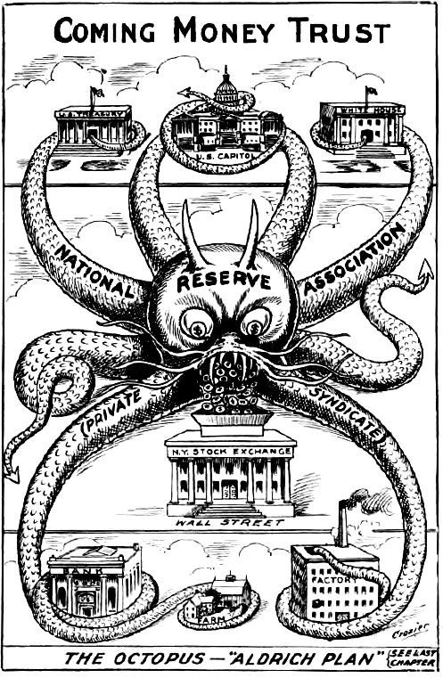



What Is Fiat Money and Who Controls It?
Who Controls the Fiat System and How Do They Beneﬁt?
There are four main players: the government, wealthy individuals, the ﬁnancial sector, and the central bank. Together, they control the ﬁat system.
The Government: The government is like the director of the ﬁat show. Along with tax collection, it is funded through new debt (bonds) issued by the Treasury. When there is insuﬃcient demand for these bonds, any remaining debt is purchased by the central bank. This means they can keep doing their activities and pursuing their interests without needing approval from the people. It's like getting a credit card without worrying about paying it back immediately. This might seem good for the government, but it comes at a cost for everyone else.
Wealthy Individuals: Wealthy individuals beneﬁt a lot from the ﬁat system. With the ability to accumulate more debt, they can invest in assets like commodities, real estate, and stocks, creating new wealth almost eﬀortlessly.
Financial Sector (banks): Banks and other ﬁnancial institutions do not directly control the ﬁat system, but greatly beneﬁt from it. Free from accountability, they can pursue and accelerate the creation of new currency via fractional reserve lending, beneﬁting from higher revenue. Banks are virtually free from consequences as they are bailed out with new ﬁat currency in order to prevent the whole system from collapsing.

Slide 17
What Is Fiat Money and Who Controls It?
The Central Bank: The central bank is the one pulling the strings, supposedly controlling the growth of the money supply. But here's the trick—the central bank is also subject to the government's laws, serving the government's interests. It's like a puppeteer being controlled by another puppeteer. The central bank might seem like the one in charge, but it's indirectly serving the government's wishes to print money out of thin air when they need it.
How they beneﬁt: These groups beneﬁt in various ways, creating a complex web of control. The government gets funds without immediate consequences, wealthy individuals and banks make money eﬀortlessly, and the central bank keeps the show running. Meanwhile, the rest of the population might feel the eﬀects, facing challenges as the system unfolds.

Slide 18

What Is Fiat Money and Who Controls It?
How They Beneﬁt: These groups beneﬁt in various ways, creating a complex web of control. The government gets funds without immediate consequences, wealthy individuals and banks make money eﬀortlessly, and the central bank keeps the show running. Meanwhile, the rest of the population might feel the eﬀects, facing challenges as the system unfolds.
In the end, the ﬁat system's puppeteers create a show where a few beneﬁt greatly but many are left wondering about the fairness of the ﬁnancial stage they ﬁnd themselves on.
The role of Central Banks
Central banks quietly shape how an economy works. Their oﬃcial job is to ensure stability, integrity, and “keep things stable”, but their methods reveal a more mysterious side.
Central banks work closely with governments, and pull the strings of monetary policy, controlling the money supply with tools like interest rates. In times of crisis, they print money out of thin air and inject it into the economy through commercial banks, making it seem like everything is okay.
They don’t just watch over things; central banks regulate commercial banks, set the rules of the game, and step in to help when banks are in trouble (acting as lenders of last resort). This web of control, while appearing protective, makes the economy and banks even more dependent on them.

Slide 19
What Is Fiat Money and Who Controls It?
Central Bank Digital Currencies: The Future of Fiat Money
Central Bank Digital Currencies (CBDCs) are the next step of ﬁat currencies. Rather than a combination of physical bills, coins, and digital payments, CBDCs are fully digital forms of ﬁat currencies issued by governments and controlled by central banks.
Imagine the currency you use every day but without any physical presence — no coins to jingle in your pocket or bills to fold. What sets CBDCs apart is the heightened level of control and monitoring they oﬀer to governments and central banks. With CBDCs, authorities gain unprecedented visibility into ﬁnancial transactions, making it easier to track and regulate the ﬂow of money.
Governments and central banks can readily adjust the form and supply of CBDCs, manipulate interest rates, and deploy monetary and ﬁscal policy tools with greater precision. In essence, CBDCs provide a more eﬃcient means for authorities to inﬂuence and manage their ﬁat currency.
While CBDCs seem to be the future of ﬁat money, the world's current monetary system already operates on a pure ﬁat standard. Fiat currencies are no longer tied to gold, resulting in a signiﬁcant expansion of the monetary supply without any real restriction.

Slide 20
How Problems Lead to Solutions

Slide 21


How Problems Lead to Solutions
Introduction to the Problem
Whoever controls the volume of money in our country is absolute master of all industry and commerce... when you realize that the entire system is very easily controlled, one way or another, by a few powerful men at the top, you will not have to be told how periods of inﬂation and depression originate.
James A. Garﬁeld, US President
Know that ﬁnancial world relies on a system that might not be as strong as it seems. The ﬁat system, held up by constant additions of paper money, seems to beneﬁt a few more than many. This chapter uncovers what the ﬁat system means for regular people and society. Finally, we explore the story of a group of individuals who noticed these problems and quietly worked to ﬁnd a solution that could change the future of human society

Slide 22
How Problems Lead to Solutions
Decreasing Purchasing Power
Monetary Inﬂation and Its Eﬀect on Purchasing Power
Monetary inﬂation is the increase in the money supply within an economy, directly impacting the average person by reducing their purchasing power. The cycle of price inﬂation starts when there's more money in circulation. This, in turn, boosts the demand for goods and services, ultimately causing prices to go up.
Let's imagine a small group of friends — Alex, Bob, and Charlie — each with a dollar in hand, and there's one bottle of water available for sale. The initial situation is simple: three people with a total of three dollars and one bottle of water. Now, suppose someone — let's say the local government — decides to give each friend
an extra dollar. Now, they collectively have six dollars. With this newfound money, they all feel like buying that single bottle of water. As all three friends want the same bottle, they start bidding against each other.
The increased demand, fueled by the extra money, prompts them to oﬀer more than the initial price for the water bottle. In the end, the bidding war causes the price of the water bottle to go up. This situation reﬂects a decline in their purchasing power.
Even though they have more money, they can't buy as many bottles of water as they could before, showcasing the impact of inﬂation on the value of their money.
In this example, the friends experienced a decrease in their purchasing power because they were using a form of money that was inﬂuenced by external factors, such as the additional dollars introduced by the government. The lack of control over the money supply, combined with increased demand, led to a rise in prices, making it more challenging for the friends to buy the same amount of goods with their extra dollars.
This illustrates how the friends' purchasing power was impacted by factors beyond their control, emphasizing the importance of understanding and questioning the systems that inﬂuence the value of our money.

Slide 23







How Problems Lead to Solutions
The Global Debt Burden and Social Inequality
Impact on Individuals — Loss of Purchasing Power
A ledger is a detailed record of all of your monetary transactions.
Whether it’s money you’re earning or spending, a ledger helps you keep track of it all.
Jaime is a college student who lives in a small apartment. He works part-time at a coﬀee shop to pay for his living expenses and tuition. As soon as he began living independently, Jaime became good at managing his own ledger.
At the beginning of 2023, he budgeted $10,000 for his living expenses for the entire year, including rent, food, and other necessities. These were his transactions for January 2023:
Date | Description | Amount | Type | Balance
01/01/2023 | Starting Balance |  |  | $1,600
01/01/2023 | Rent for January | $800 | Debit | $800
01/05/2023 | Groceries | $100 | Debit | $700
01/15/2023 | Part-time paycheck | $500 | Credit | $1,200
01/20/2023 | Gas for car | $350 | Debit | $850
01/30/2023 | Textbooks | $150 | Debit | $700
This ledger shows that Jaime’s starting balance was $1,600 out of which he spent (a debit) $800 to pay rent for the month. He then spent $100 on groceries and received $500 (a credit) in pay for his part-time job, bringing his balance to $1200.
He then spent money on gas and textbooks, bringing his balance down to $700 at the end of the month.

Slide 24
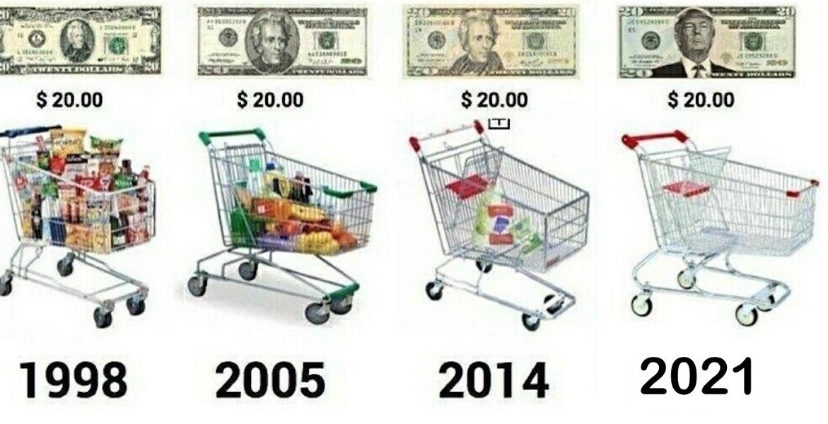
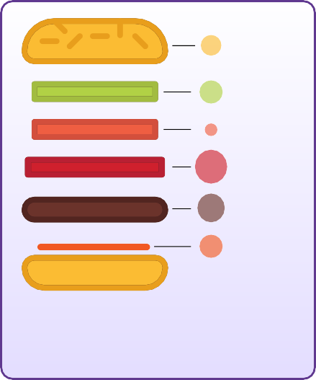
How Problems Lead to Solutions
Twelve months later, Jaime is having lunch with his grandfather with whom he shares the details of his budget for 2024. Jaime notices that his budget is not stretching as far as it used to and that his cost of living has increased signiﬁcantly over the past year. While Jaime is wondering how this could be, his grandfather shows him the next image.
Twelve months later, Jaime is having lunch with his grandfather with whom he shares the details of his budget for 2024. Jaime notices that his budget is not stretching as far as it used to and that his cost of living has increased signiﬁcantly over the past year.
While Jaime is wondering how this could be, his grandfather shows him the next image.
+10.1%
Roll
+12.7%
Lettuce
+0.4%
Tomato
+17.7%
Bacon
+14.8%
Ground Beef
+9.2%
Sauce Condiments
His grandfather says: “In 1956, I was just a young man starting out in the world. I remember that I used to earn $380 a month as a factory worker. It may not seem like much, but it was a decent wage at the time. In fact, I was able to save up enough money to buy my own house in the suburbs.”
The grandfather continues: “The costs of things were very diﬀerent in the past century. For example, in 2020, purchasing 30 Hershey’s chocolate bars would cost you $26.14. However, if we go back in time to 1913, the cost for the same number of Hershey’s bars would only be $1.00.”This signiﬁcant diﬀerence in price highlights the change in purchasing power over time and how it has shifted over the years due to inﬂation.
* Based on retail prices, urban consumers.

Slide 25

How Problems Lead to Solutions
Jaime: “Wow, that’s really interesting, Grandpa. How did you experience this yourself when you were younger?”
Grandfather: “Oh, Jaime, everything was just much cheaper when I was young. A loaf of bread would only cost $0.18, and you could buy a gallon of gasoline for just $0.29. It is unbelievable how much the cost of living has gone up.”
After the conversation with his grandfather, Jaime goes home to take another look at his ledger. He quickly discovers that he needs to budget an additional $1,000 for 2024 to be able to buy the same basket of goods and services that he purchased in the previous year. This means that his purchasing power has decreased by $1,000 as he now has to spend more money to buy the same goods and services. While Jaime's salary onlyincreases minorly, his costs of living skyrockets every year.
The following table shows Jaime’s costs in the ﬁrst and second years, as well as the percentage increase in price.
In order for Jaime to live under the same standard of living, he will need to work more hours per week to receive an additional $1,000.
Item | Cost Year #1 | Cost Year #2 | % Increase
Rent | $4,000 | $4,500 | 12.5%
Groceries | $2,000 | $2,300 | 15%
Necessities | $4,000 | $4,200 | 5%
Total | $10,000 | $11,000 | 10%
To illustrate, someone oﬀering Jaime a
time-travel choice — either take $100 in 1913 or wait until 2023 and receive only $3 — is like choosing between a past shopping spree or getting just a few small treats today. The signiﬁcant diﬀerence in value shows how much money's purchasing power has decreased over the years.

Slide 26
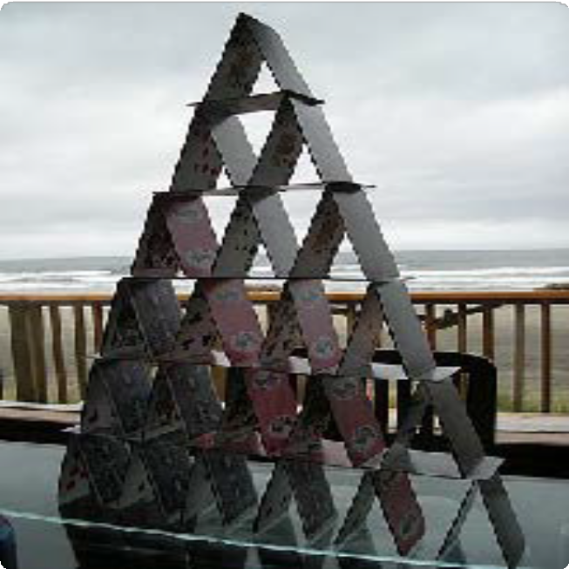
How Problems Lead to Solutions
In essence, the impact of the ﬁat system paints a challenging picture for individuals globally. In the ﬁat system, prices rise, incomes stagnate, and the struggle to survive becomes a daily battle. While certain groups get richer, most individuals worldwide stay dependent on a system that makes them poorer and poorer.
Impact on Society — Increasing Wealth Inequality
In a society based on sound money, a government’s ﬁnancial decision-making is tied to the people's approval. However, in the ﬁat system, governments can go into unlimited debt on the backs of their citizens.
The power to print money at will often leads to political centralization. The ﬁat system enables governments to accumulate massive debts, making decisions that beneﬁt themselves rather than the majority. Superpowers like the United States gain a competitive edge due to this phenomenon. They can print money endlessly to fund their plans, including wars. This ability allows these dominant nations to control, inﬂuence, and engage in geopolitical conﬂicts, creating a global power imbalance. Wars and major actions to control others become ﬁnancially feasible for superpowers while others without the same ﬁnancial ﬂexibility face limitations.
Under the ﬁat system, wealth does not distribute itself evenly. Instead, it tends to concentrate in the hands of a select few. This phenomenon is like playing a game of Monopoly where a handful of players possess almost all the hotels and properties while the majority struggle to stay aﬂoat. The ﬁat system has become a tool for certain groups to concentrate wealth. Money printing allows governments and their tight collaboration with central banks to inject more currency into the economy, and the recipients of this newly created money are those with existing wealth and status — powerful entities and individuals.

Slide 27


How Problems Lead to Solutions
The Global Debt Burden
As a result of the ﬁat system, governments across the globe ﬁnd themselves stuck in an enormous web of debt, caught up in what is called, ”The global debt spiral.” Imagine a scenario where you borrow more money than you can ever hope to repay. This is happening on a massive scale worldwide. Governments, drowning in debt, have been caught in a dangerous game of accumulating more debt than they can ever pay back. It's a story of reckless spending, borrowing, and a lack of foresight that now pushes nations around the world to the brink of ﬁnancial disaster.
As of today, the U.S. federal government has added a staggering $10 trillion of new debt since 2019. Total debt has skyrocketed from about $23 trillion during the fourth quarter of 2019 to an astronomical $34 trillion today. The pace at which governments globally churn out new debt isn't slowing down; in fact, it's accelerating. The year 2023 was projected to be the most debt-additive year since the turbulent times of 2021, marked by the COVID pandemic.

Slide 28
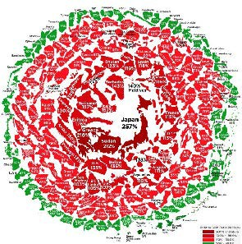
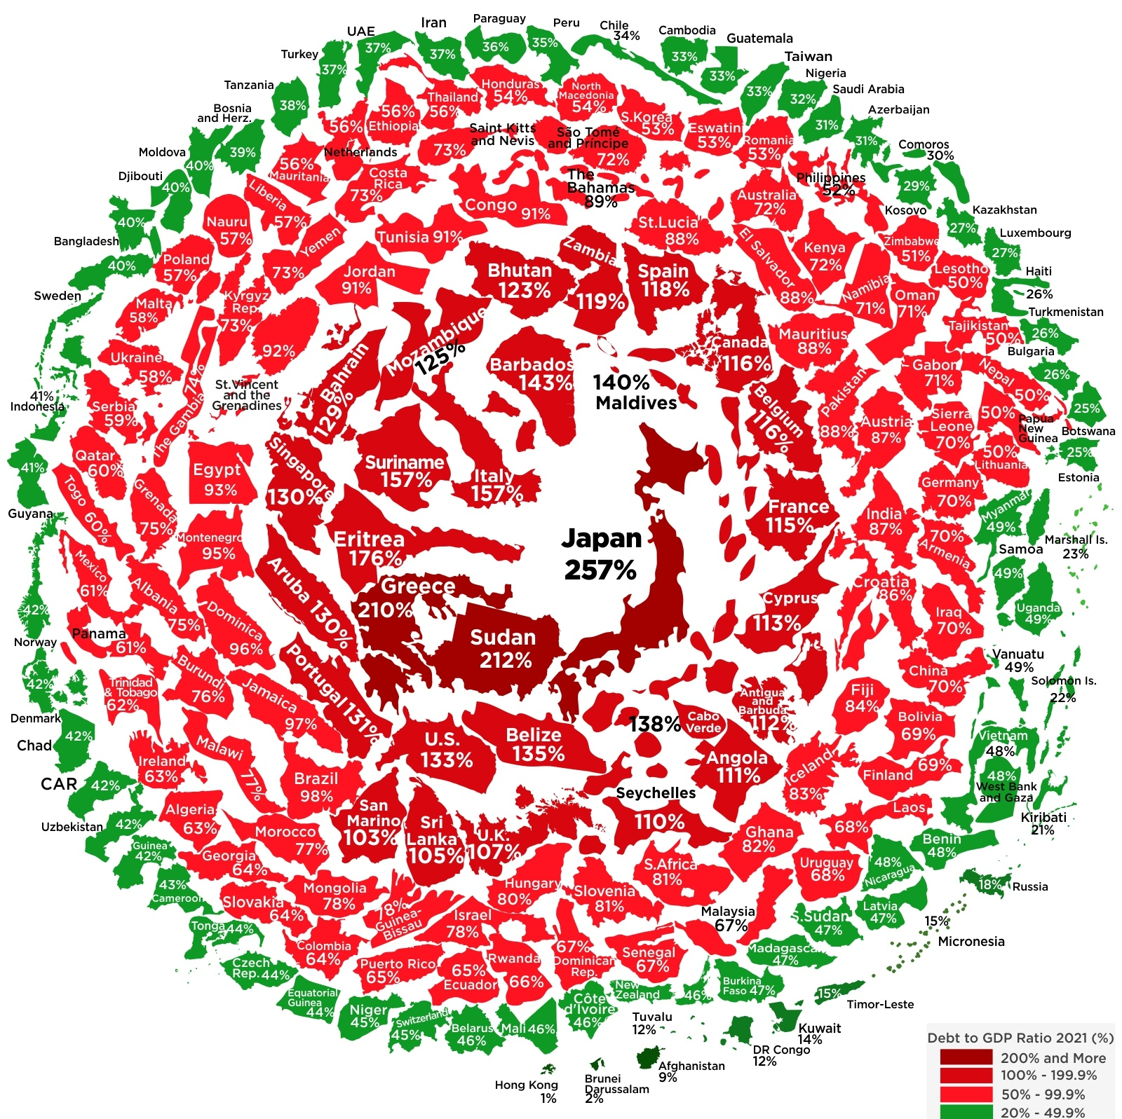

How Problems Lead to Solutions
The State of the World´s Government Debt
So, what does this mean for the individuals and societies that already need to deal with the consequences of the ﬁat system? The debt spiral they are caught up in is like a snowball rolling down a hill—it just keeps getting bigger, and we're not sure how to stop it.
The consequences mentioned earlier, from wealth inequality to societal unrest, won't fade away. Instead, the global debt burden has reached a point of no return, ensuring that things are destined to get worse.
Debt to GDP Ratio 2021 (%)
200% or more
100% — 199.9%
50% — 99.9%
20% — 49.9%
10% — 19.9%
Less than 10%

Slide 29

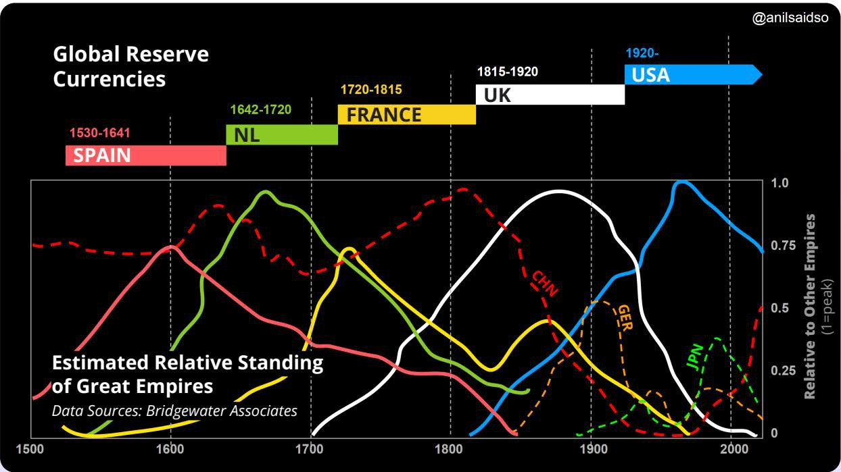


How Problems Lead to Solutions
I don’t believe we shall ever have good money again until we take the thing out of the hands of government… all we can do, is by some sly, roundabout way, introduce something that they can’t stop.
Friedrich Hayek
Nobel Prize Winner of Economics

Slide 30

How Problems Lead to Solutions
The Cypherpunks and the Quest for a Decentralized Currency
We have observed a progressive capture of money by banks and governments throughout history, leading to the ﬁat system we know today and its disastrous consequences for society. But the rise of new technologies like encryption and the internet have allowed new ideas to emerge, such as independent digital money — free of government intervention, open and accessible to all. Let's dive into the journey of those leading this revolutionary movement: the Cypherpunks.
The Cypherpunks
The computer can be used as a tool to liberate and protect people, rather than to control them
Hal Finney
The second half of the 20th century saw the rise of multiple technological breakthroughs, like the computer and the internet, paving the way for a new digital age.
A group of people discovered that these massive innovations would soon transform how society functions. They foresaw both the potential and the danger of the personal computer, either as a freedom-enabling tool to empower the individual or as a tool for complete control and surveillance.

Slide 31

How Problems Lead to Solutions
These people were called the Cypherpunks. They emerged as a loosely connected group of activists, cryptographers, programmers, and privacy activists who shared a common vision: the pursuit of privacy, security, and a decentralized digital future.
The term "Cypherpunk" is a fusion of "cypher," referring to cryptographic code, and "punk," representing the countercultural ethos of rebellion.
The Cypherpunks believed in cryptography’s power to protect individual liberties. Their goals included developing tools to secure online communications, anonymize internet activities, and establish digital currencies to operate beyond the control of centralized authorities.
The Cypherpunks understood the consequences of the ﬁat system and saw the threat of an “Orwellian future.” They believed they had to ensure that the personal computer and the internet would become good things for humanity instead of tools that could exacerbate the stat’s control over its people.
THE DEFINITION OF AN ORWELLIAN FUTURE:
An Orwellian future refers to a dystopian vision inspired by George Orwell's works. The term is associated with a nightmarish and totalitarian society characterized by oppressive government control, extensive surveillance, propaganda, and the manipulation of information. The term "Orwellian" often describes a scenario where citizens' freedoms and individual autonomy are severely restricted, dissent is suppressed, and reality is distorted to serve the interests of a powerful and authoritarian regime. The concept is named after George Orwell, who, in his writings, warned against the potential dangers of unchecked government power and the erosion of fundamental human rights.

Slide 32




How Problems Lead to Solutions
Centralized vs. Decentralized Systems
Centralized Systems: One Ruler, Many Problems
In a centralized system, everything revolves around one main authority, like a tall building in a city. This authority controls how the entire system works. Think of traditional banks as an example, where a small group makes all the decisions.
Real-world example: In 2022, during peaceful protests in Canada, banks froze protestors' accounts, showing how a central authority could step in and control ﬁnancial access.
One of the Cypherpunks most notable inventions was the creation of cryptographic tools and protocols. In 1991, Phil Zimmermann introduced PGP (Pretty Good Privacy), email encryption software that became a ﬂagship project. PGP allowed users to send encrypted messages over the internet without anyone except the intended recipient being able to decrypt them. Before that, any message sent over the internet could be intercepted and read by others, like governments.
The Cypherpunks thought that the breakthrough of encryption, along with the internet and the computer, provided a solid foundation for the creation of decentralized networks in the digital space, allowing individuals to communicate and transact on the internet privately and without interference from a central authority
The Cypherpunks were on the right track to fostering a brighter future for humanity, where technology would be a tool to maximize freedom instead of control. The only missing pieces were a decentralized network and a digital currency.

Slide 33







How Problems Lead to Solutions
Problems with Centralized Systems:
Central point of failure: If something goes wrong with the central authority, the whole system can collapse.
Control: A small group at the top has all the control and power, often making decisions that beneﬁt them more than everyone else.
Ineﬃciency and intermediaries: Like traﬃc jams in a city, centralized systems can become slow and expensive because of unnecessary middlemen.
Lack of autonomy: People might not get to make their own ﬁnancial choices; it's all decided by the top authority.
Censorship and restriction: Just like some parts of a city can be blocked oﬀ, centralized systems may block or limit access to certain ﬁnancial resources.
Scaling challenges: When more people need ﬁnancial services, centralized systems may struggle to keep up.
Security risks: Problems with the central authority can put the whole system at risk of cyberattacks.
Lack of transparency and trust: The inner workings of centralized systems can be hard to understand, making it tough for people to trust them.
Decentralized Systems: Power to the People
Now, think of a decentralized system like a big forest. Each tree represents a separate part, and the whole forest represents the entire system. Unlike a city with a single central point, a decentralized system is more like a resilient forest that can keep going even if one part faces problems.

Slide 34

How Problems Lead to Solutions
Beneﬁts of Decentralized Systems:
Enhanced resilience and reliability: There is no single point of failure, which makes the system strong, even if there are some issues.
Increased security: With the right encryption/protection, a decentralized system is better at resisting control from a single authority.
Greater sovereignty: People have more control over their money, data, and decisions.
Improved transparency: Everyone sees the same information, making the system more trustworthy.
Permissionless and limitless nature: Anyone can join or take part, making it an inclusive ﬁnancial system.Equal opportunities: Everyone has a fair chance to contribute and have a say.
Enhanced privacy: Data is distributed across multiple participants and mostly pseudonymous, making decentralized systems more private.
While decentralized systems have lots of advantages, making decisions together can be a bit tricky. It requires everyone to work together.
Changing How Power Is Wielded
In a world of centralized and decentralized systems, it's all about who holds the power. Centralized systems give power to a small group, while decentralized systems spread it out, letting everyone have a say. This shift in power would mean a fairer and more democratic future, where many people inﬂuence the system that shapes their lives.

Slide 35


How Problems Lead to Solutions
Brief History of Digital Currencies
One of the most pivotal concepts discussed by the Cypherpunks was digital cash. The Cypherpunks realized that the state and money needed to be separate to ensure that the future would beneﬁt the common good.
David Chaum's groundbreaking work on cryptographic protocols for secure and private transactions laid the groundwork. The downside was that this protocol required a central authority to function eﬃciently, raising concerns about a single point of failure and potential censorship.
In the years that followed, multiple Cypherpunks attempted to iterate each other's ideas to create a workable solution for a digital currency free from government control. The table below describes several key innovations the Cypherpunks developed in their quest to create digital cash:
Name and Date | Description | Limitations
E-Cash (1982) | David Chaum's E-Cash was an early concept of electronic cash, focusing on privacy through cryptographic techniques. | Required a central authority, raising concerns about a single point of failure and potential censorship.
DigiCash (1990) | DigiCash, founded by David Chaum, aimed to create a digital form of currency with an emphasis on privacy. | The centralized model contributed to its eventual bankruptcy in 1998.
B-money (1996) | B-money, proposed by Wei Dai, was a theoretical proposal for an anonymous, distributed electronic cash system. | Lacked a practical implementation; remained a conceptual idea.
Hashcash (1998) | Hashcash, developed by Adam Back, was a proof-of-work system designed to limit email spam and denial-of-service attacks. | Did not directly address the double-spending problem associated with digital currencies.
Bit Gold (1998) | Bit Gold, proposed by Nick Szabo, described a decentralized digital currency system with elements of proof-of-work. | Never implemented, remained a theoretical concept.
e- Gold (2004) | e-Gold was a centralized digital currency backed by physical gold, allowing users to buy and transfer e-Gold units. | Legal issues led to its closure in 2009, highlighting challenges associated with centralized digital currencies.

Slide 36
Q&A

